Slide 1
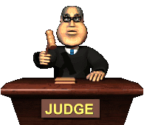
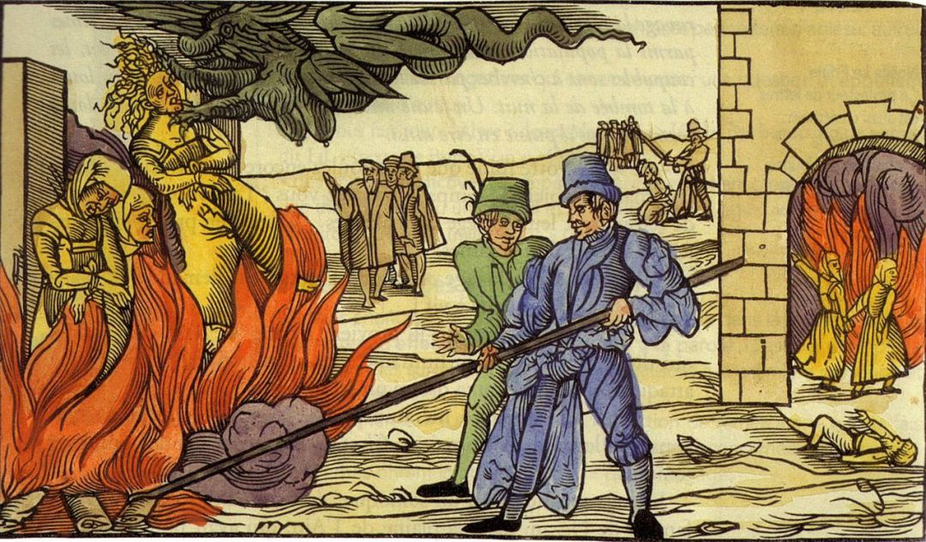
By Sadie McFerran

Slide 2
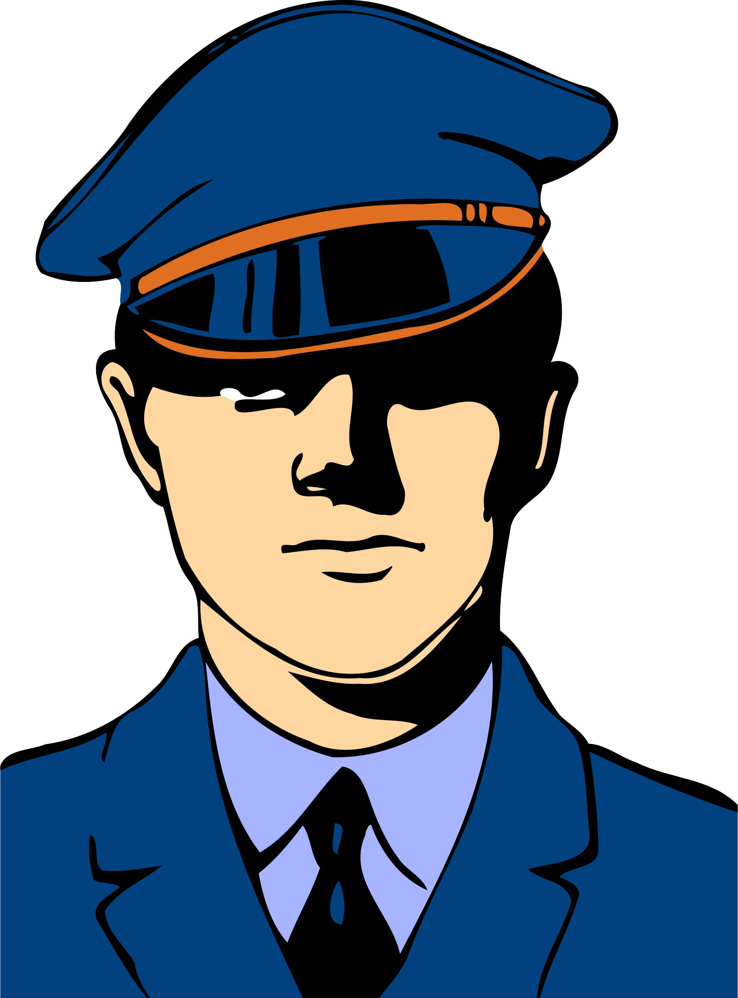
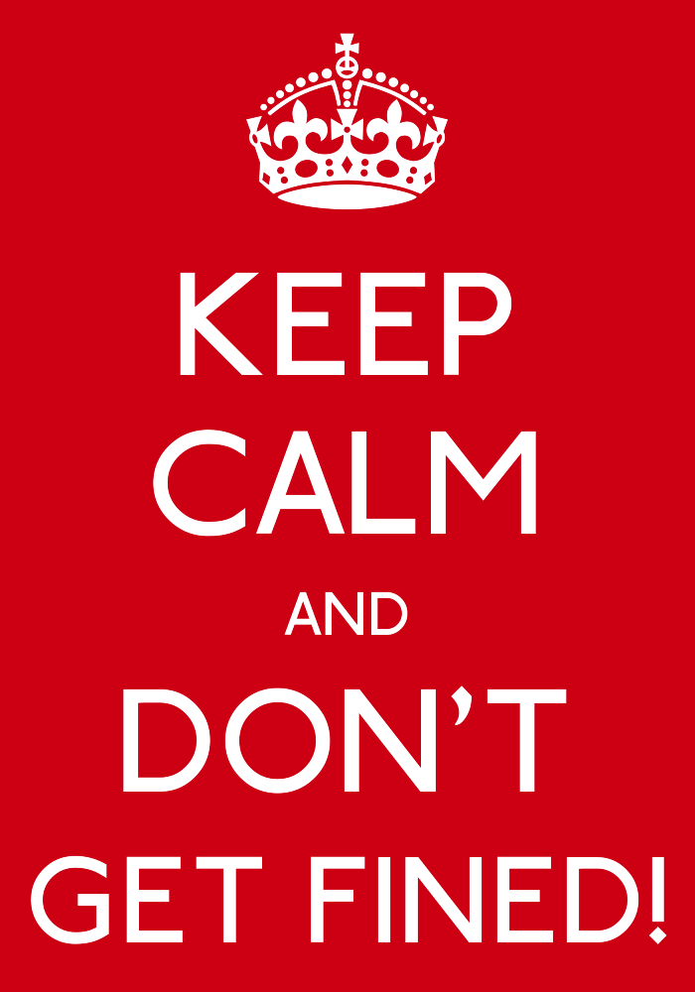
The Justice System
In Medieval Times
There were NO police.
If you spotted a crime you would shout as loud as you could so people would come to help.
If someone was caught they would be sent to the local Barons House!
The Baron would decide a punishment. Usually a fine!
People in the village had to help, otherwise they would be fined!

Slide 3
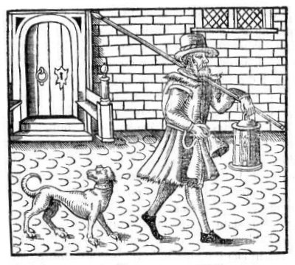
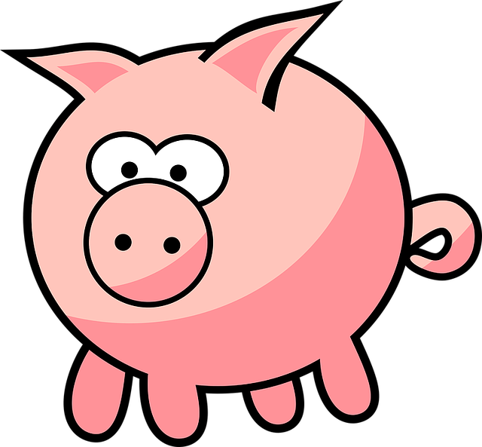
Crimes in The Middle Ages
The worst crime that you could commit in Medieval times was high treason against the King.
If you were a women, and committed this crime, they would burned you alive. But if you were a man, the punishment was that you were hung, drawn and quartered.
There were a few crimes back then. Some of these include:
Gossiping
Witchcraft
Not working hard enough
Letting your dogs attack a pig
Murder
High Treason
I think I'm dead. *oink*

Slide 4
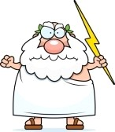
How did they tell who was guilty and who was not?
People believed god punished bad people and rewarded good people.
They used something called TRIAL BY ORDEAL to decide whether someone was guilty or not.
1) ORDEAL BY FIRE
Step one: Carry red hot iron bar for three steps
Step two: Hand is bandaged. You return in three days
VERDICT:
If wound is healed, god must think you are worth saving and innocent
If it is infected, you must be guilty and will be executed

Slide 5
2) ORDEAL BY WATER
Step one: Tied up
Step two: Thrown into a lake/ river
VERDICT:
Water is pure, like God
If you float the water (god) rejects you and you will be executed
If you drown god must want you in heaven, therefore, you are innocent

Slide 6
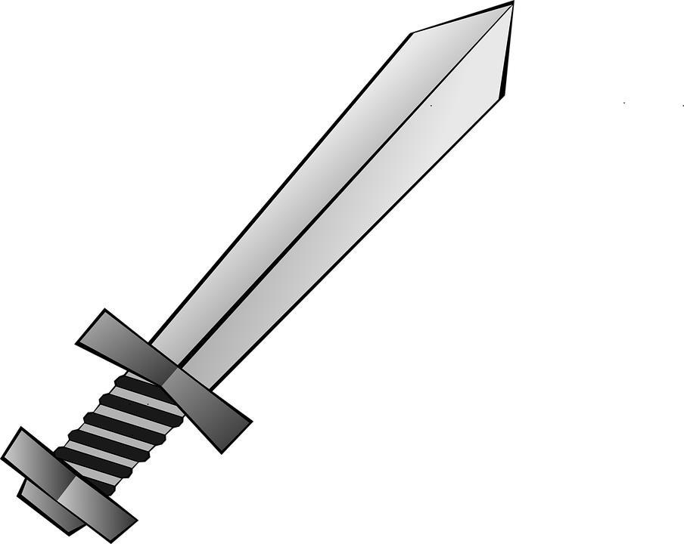
3) ORDEAL BY COMBAT
This was a trial for rich people. The accused would fight the accuser. You would hire a fighting champion to fight in your place.
Step one: Select weapons made of wood or stone
Step two: Fight for as long as possible starting from sunrise
VERDICT: God would give the winner extra strength, the first one to surrender was guilty and would've been killed

Slide 7
If the laws were broken the local Lord had the power to PUNISH.
Punishments happened in public as a warning to others
There were quite a few punishments back in the middle ages.

Slide 8
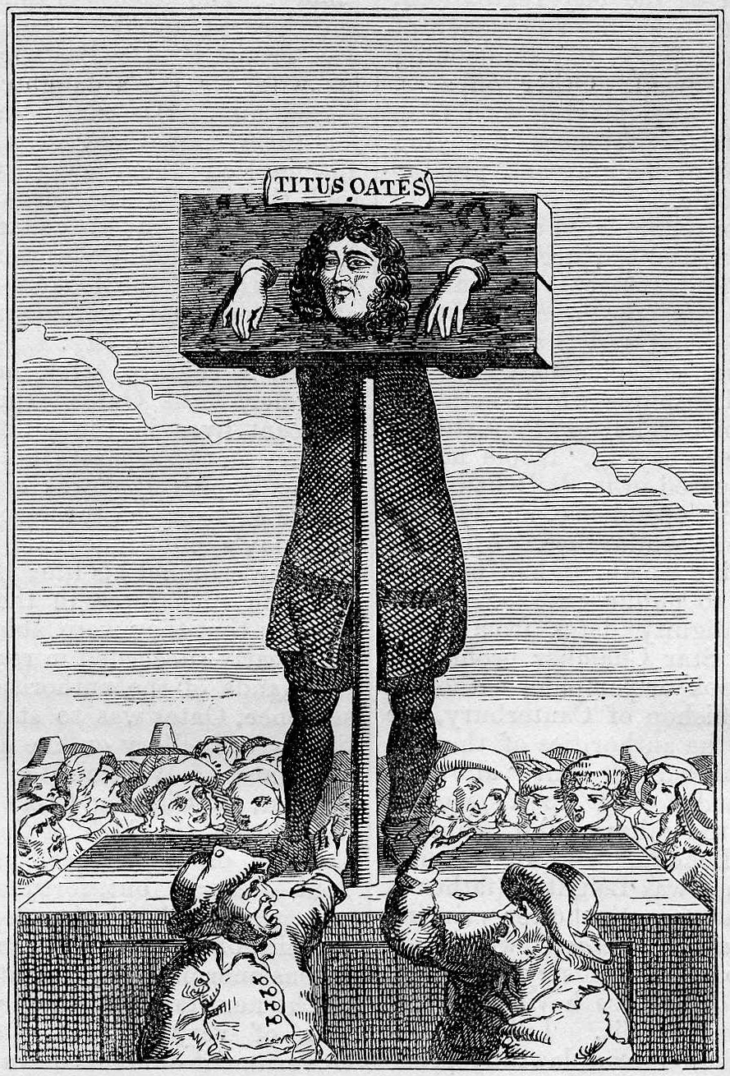
Used for SMALL CRIMES.
Sometimes ears were nailed to the wood
A large stone was sometimes hung around their neck
Children had a finger pillory for their fingers

Slide 9
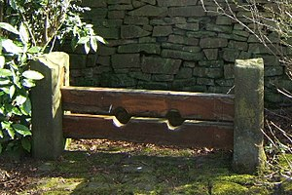
Used for LESS SERIOUS CRIMES.
Prisoner was locked in the stocks for a certain time
People threw rotten vegetables at them

Slide 10
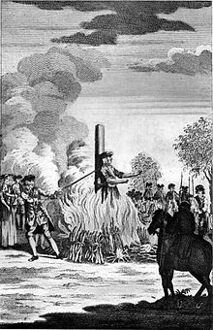
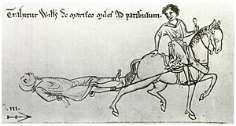
For serious crimes, the punishment was DEATH!
They killed people in a few different ways. Some of these ways include:
Burnt at the stake
Hanging
Beheading
And the worst... HUNG DRAWN AND QUARTERED!

